Slide 1
Depression Detection from Activity Patterns: A Machine Learning Study
Presented BY ANANYA P SHETTY

Slide 2
Problem
Depression is a prevalent mental health condition with significant societal impact. Detecting and classifying individuals as depressed or non-depressed based on behavioural data can provide valuable insights for early intervention and support. This study aims to leverage time series data analysis and machine learning techniques to classify individuals into these two categories. A TimeSeriesForest classifier was selected for its suitability in handling time series data.Hyperparameter tuning was a crucial aspect of the methodology, and Randomized Search CV was employed to identify the optimal combination of hyperparameters. This process involved systematically exploring hyperparameter spaces to maximise classification accuracy.

Slide 3
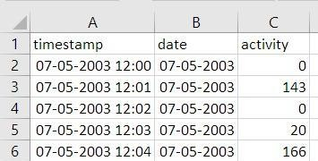
DATASET:
The dataset used in this research consists of minute-by-minute activity records collected from a diverse group of 55 subjects, including 23 depressed patients and 32 non-depressed individuals. To prepare the data for analysis, a rigorous preprocessing step was applied. This involved grouping the data by date and hour and calculating hourly average activity levels.
DATA SOURCE:
Depressed Patients: The dataset includes 23 separate CSV files, each dedicated to a specific depressed patient. These files contain detailed activity records for each patient.
Non-Depressed Individuals: Additionally, the dataset encompasses 32 distinct CSV files, each corresponding to a non-depressed individual. These files contain activity data for individuals who do not exhibit signs of depression
SNAPSHOT OF THE ORGINAL DATASET

Slide 4
PROCEDURE
Data Preprocessing: Data cleaning ensures data integrity and consistency. Missing values are handled to avoid data gaps. Merging of "Control" and "Condition" datasets into a single dataset. Introduction of a binary "Status" column (1 for depressed patients, 0 for non-depressed patients) Hypothesis Testing: Objective: Determine if mean activity differs significantly between the two groups. Statistical tests (e.g., t-tests or ANOVA) are conducted. Null hypothesis (H0) There is no significant mean difference between them; alternative hypothesis (Ha) There is a significant difference. Model Training: Develop a predictive model to classify individuals as patients or non-patients. Machine learning algorithms are used. Model hyperparameters are tuned for optimal performance. Descriptive Analysis for Model Deployment: Model Evaluation: Assess performance metrics (accuracy, precision, recall, F1-score,AUC-ROC curve ). Feature Importance: Identify key variables contributing to predictions.

Slide 5
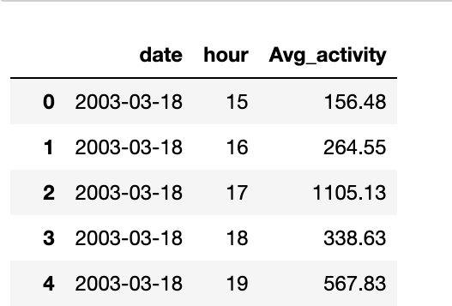
Data Preprocessing
As part of our data preprocessing pipeline in Python, we utilised the “groupby” function to aggregate and summarise the raw activity data. The primary objective was to transform the data into a more manageable and meaningful format for subsequent analysis.
Grouping by Date and Hour:
The initial step involved grouping the data based on two key temporal dimensions: "Date" and "Hour." This grouping allowed us to organise the dataset into hourly segments, which is conducive to identifying patterns and trends in the activity data.
Calculating Hourly Averages:
Within each hourly group, we calculated the average activity level by summing all the data points collected on a minute-by-minute basis and then dividing this sum by 60 (representing the number of minutes in an hour). This computation yielded a representative hourly average activity value.
SNAPSHOT AFTER DATAPREPROCESSING

Slide 6
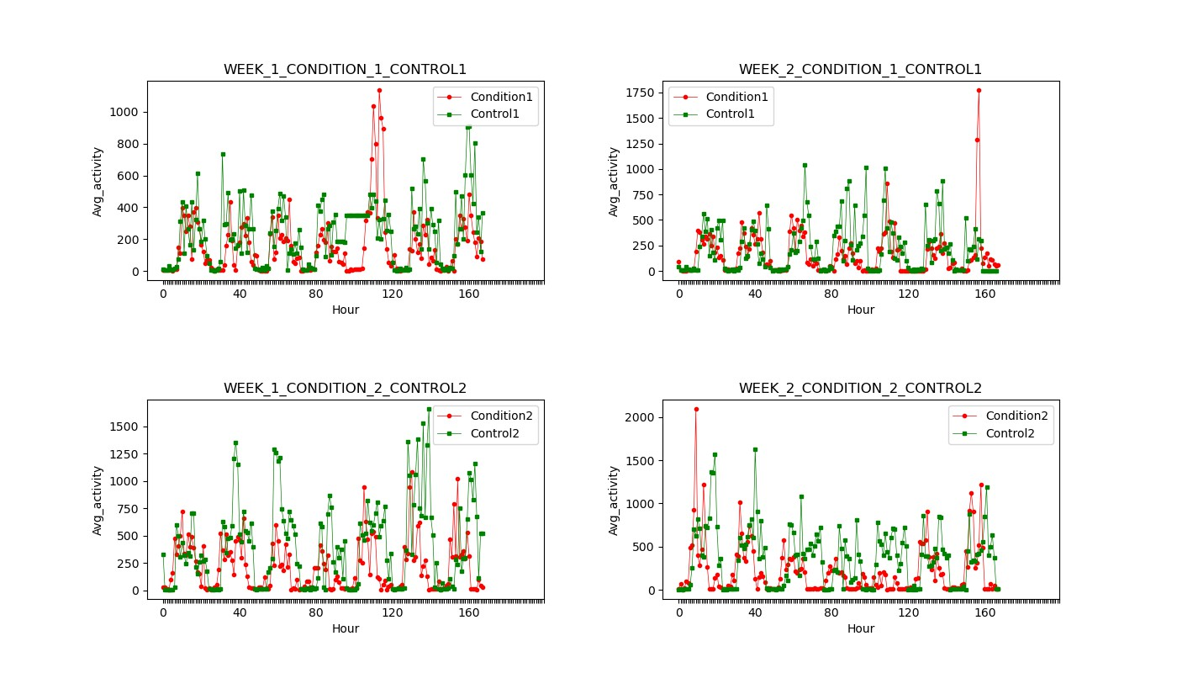
HYPOTHESIS TESTING

Slide 7
RESULT
After extensive experimentation, the final model, trained with the best-performing hyperparameters, achieved an impressive accuracy of 78.6% and AUC of 0.85 on a separate test dataset. This outcome underscores the potential of time series analysis and machine learning in effectively classifying individuals as depressed or non-depressed based on their activity patterns.
The successful classification of individuals into depressed and non-depressed categories using behavioural data highlights the promise of this approach for early detection and support in mental health. By leveraging time series data and machine learning, this study offers a valuable contribution to the field of mental health research and underscores the importance of data- driven approaches in addressing mental health challenges. Further research and validation are warranted to refine and generalise this classification method for broader applications in mental health monitoring and intervention.

Slide 8
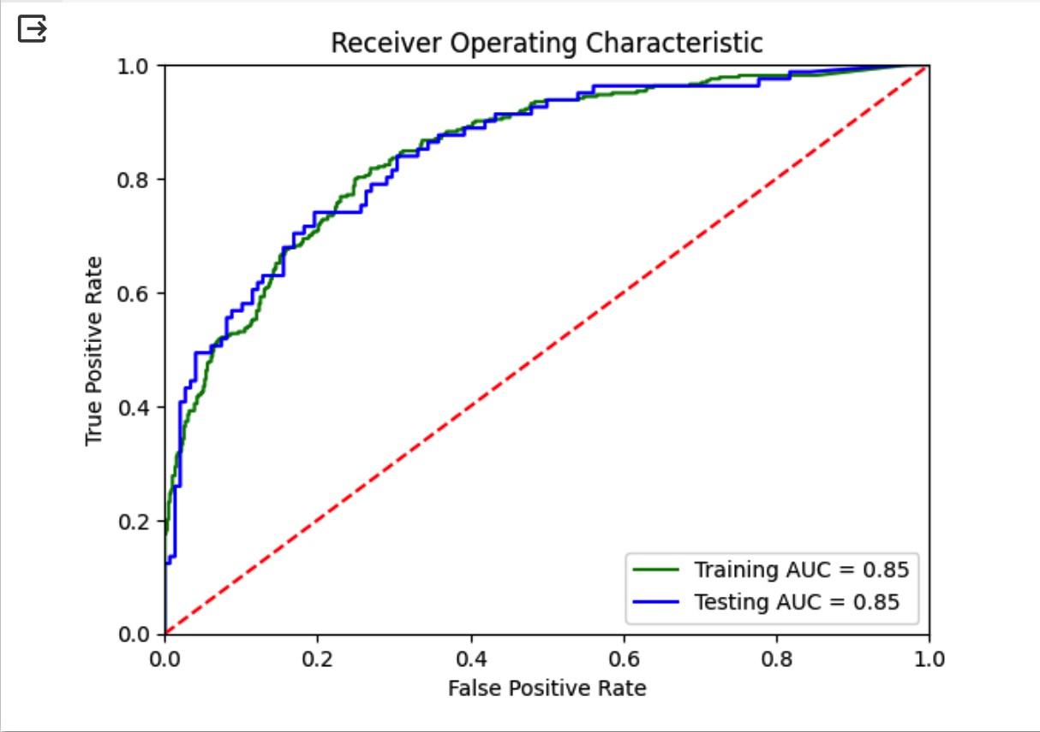
The roc-auc curve

Slide 9
THANK YOU

